Slide 1
What you learn today
Features
Data Transformation
Kernels
Support Vector Machine (SVM)
Classification
Similarity in the feature space
Regression (SVR)
Anomaly detection (one class SVM)

Slide 2
Features
Transform the variables such that the output values are “nicer.”
Maybe introduce new dependent variables

Slide 3
Examples (1/2)
Physics: Inverse-Square Law (Magnetic Force & Gravity) ⚡
Magnetic force and gravitational force follow the inverse-square law (∝ 1/distance²).
Transforming distance into 1/d² makes the relationship linear and easier to model.
Audio Processing: Music Genre Classification 🎵
Raw audio signals are just waveforms, which don’t directly indicate patterns like rhythm or melody.
Transforming them into a spectrogram (time vs. frequency) helps identify features related to different music genres.
Health & Medicine: Disease Risk Prediction 🏥
The probability of developing diseases (e.g., cancer risk vs. age) often follows a logistic or exponential pattern.
Using transformations like logistic functions helps capture the trend more effectively.

Slide 4
Examples (2/2)
Projectile Motion: Basketball Trajectory 🏀
The path of a basketball follows a parabolic trajectory (y = ax² + bx + c).
Instead of modeling raw x and y coordinates, transforming it into a quadratic equation helps understand the motion better.
Computer Vision: Object Recognition in Images 🖼️
Raw pixel values don’t directly reveal shapes or objects.
Applying edge-detection filters (e.g., Sobel or Gabor) extracts meaningful features like edges and textures.
Biological Growth: Sigmoid Curves in Nature 🧬
Many biological processes (e.g., bacteria growth, human height vs. age) follow a sigmoid rather than a linear pattern.
Using transformations like log or logistic functions captures the actual growth trend more accurately.

Slide 5
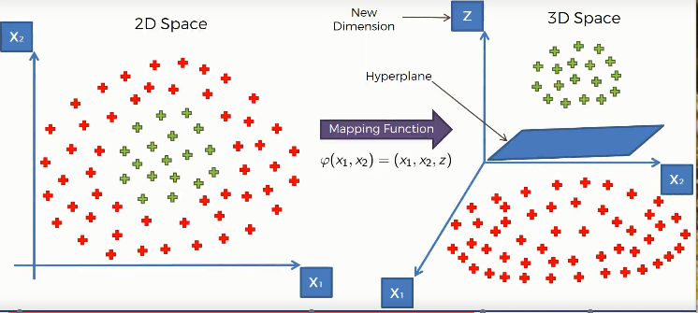
Adding a new feature

Slide 6


Adding a new feature
New Feature (Z): $\frac{1}{r^{2}}$ where $r$ is the distance from

Slide 7
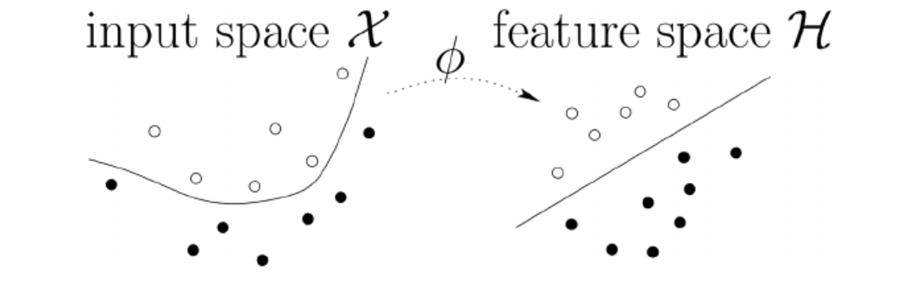
Features
Transform the variables such that the output values are “nicer.”
Maybe introduce new dependent variables

Slide 8
How to find these features?
Domain knowledge
Some good default values to test (polynomials)
Statistical methods: learn features from the data (Neural Networks)

Slide 9

Code
https://bit.ly/4bLxziO

Slide 10
What you learn today
Features
Data Transformation
Kernels
Support Vector Machine (SVM)
Classification
Similarity in the feature space
Regression (SVR)
Anomaly detection (one class SVM)

Slide 11
Think of your data as vectors
Every data point is a vector:
so each row of your Pandas Dataframe is a vector.
Different ways to think of vectors:
A vector is a list of numbers that is ordered
A vector is an object that has direction and magnitude
Application: To define the similarity of two data points, we may want to think of them as vectors and see the angle between these two vectors

Slide 12

Inner Product
https://bit.ly/3R3cGWG

Slide 13
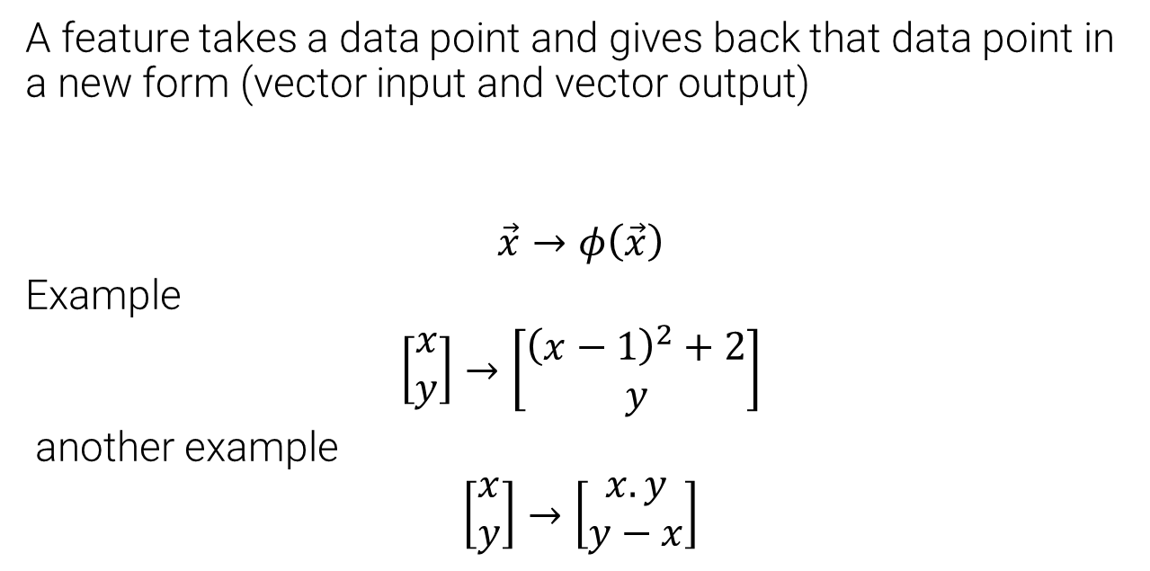
Review: what is a feature
A feature takes a data point and gives back that data point in a new form (vector input and vector output)
$$\vec{x}→φ\left(\vec{x}\right)$$
Example
$$\left[\begin{matrix}x \\ y\end{matrix}\right]→\left[\begin{matrix}{\left(x−1\right)}^{2}+2 \\ y\end{matrix}\right]$$
another example
$$\left[\begin{matrix}x \\ y\end{matrix}\right]→\left[\begin{matrix}x.y \\ y−x\end{matrix}\right]$$

Slide 14
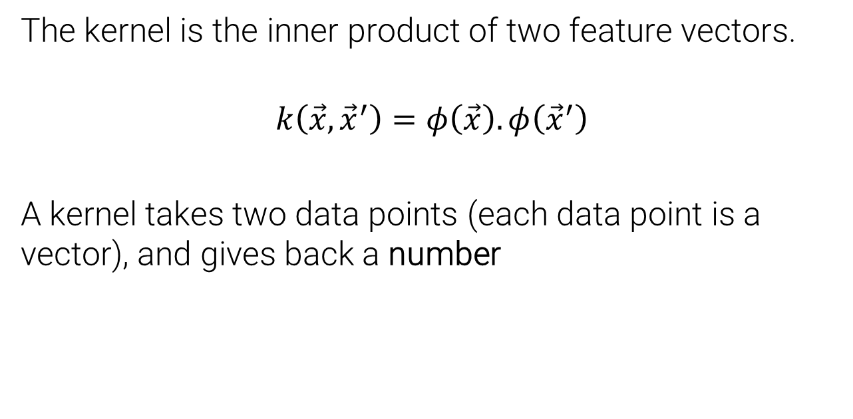
What is a Kernel
The kernel is the inner product of two feature vectors.
$$k\left(\vec{x},{\vec{x}}^{′}\right)=φ\left(\vec{x}\right).φ\left({\vec{x}}^{′}\right)$$
A kernel takes two data points (each data point is a vector), and gives back a number

Slide 15
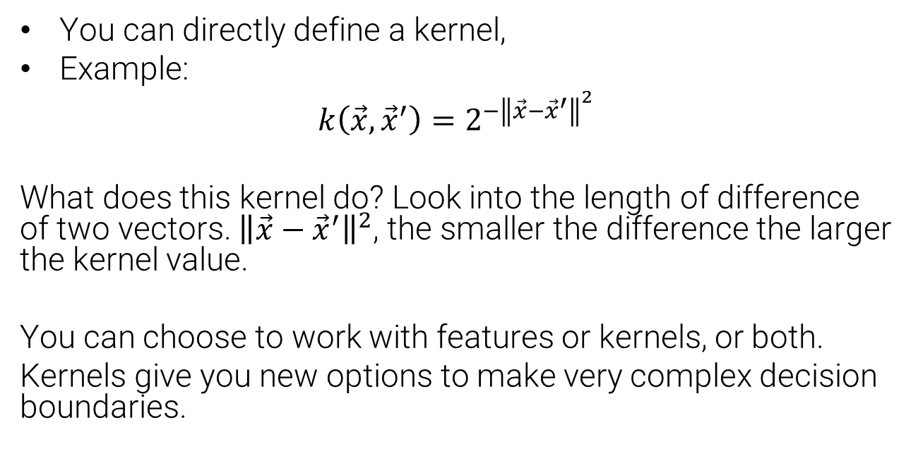
Kernel
You can directly define a kernel,
Example:
$$k\left(\vec{x},{\vec{x}}^{′}\right)=2^{−{\left\|\vec{x}−{\vec{x}}^{′}\right\|}^{2}}$$
What does this kernel do? Look into the length of difference of two vectors. ${\left\|\vec{x}−{\vec{x}}^{′}\right\|}^{2}$, the smaller the difference the larger the kernel value.
You can choose to work with features or kernels, or both.
Kernels give you new options to make very complex decision boundaries.

Slide 16

Code
https://bit.ly/3DC9yhz

Slide 17
What you learn today
Features
Data Transformation
Kernels
Support Vector Machine (SVM)
Classification
Similarity in the feature space
Regression (SVR)
Anomaly detection (one class SVM)

Slide 18
What is a Support Vector Machine?
Advanced Machine learning algorithm that is:
Invented in 1993 (newer than neural networks)
Good at high dimensional feature spaces
Not so good at providing probabilities
Gaussian Process is the probabilistic counterpart
(sklearn.gaussian_process — scikit-learn 1.6.1 documentation)

Slide 19
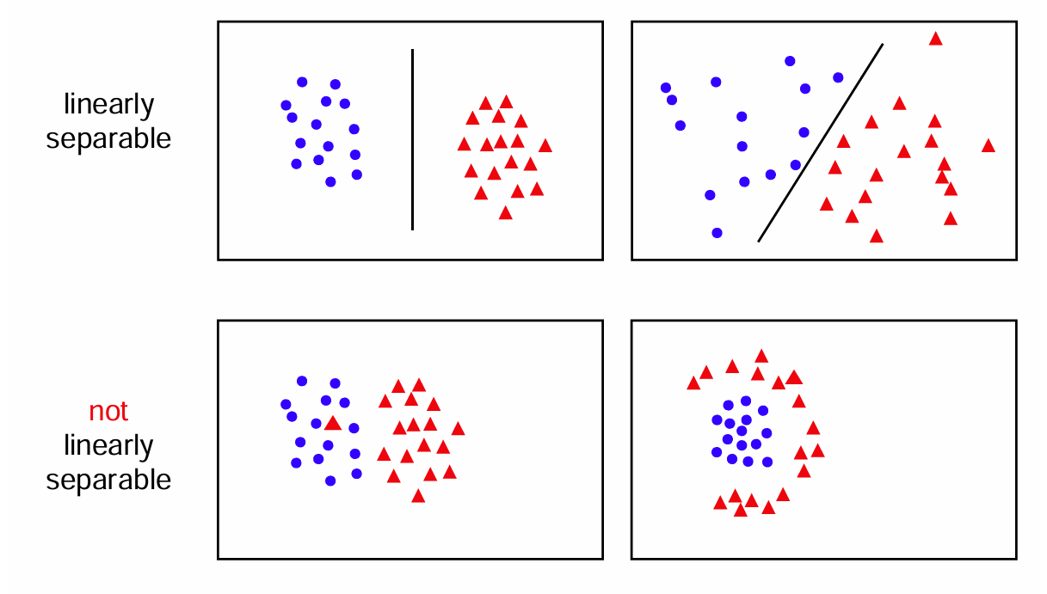
Can we separate with a line?
robots.ox.ac.uk - lect2.ppt

Slide 20
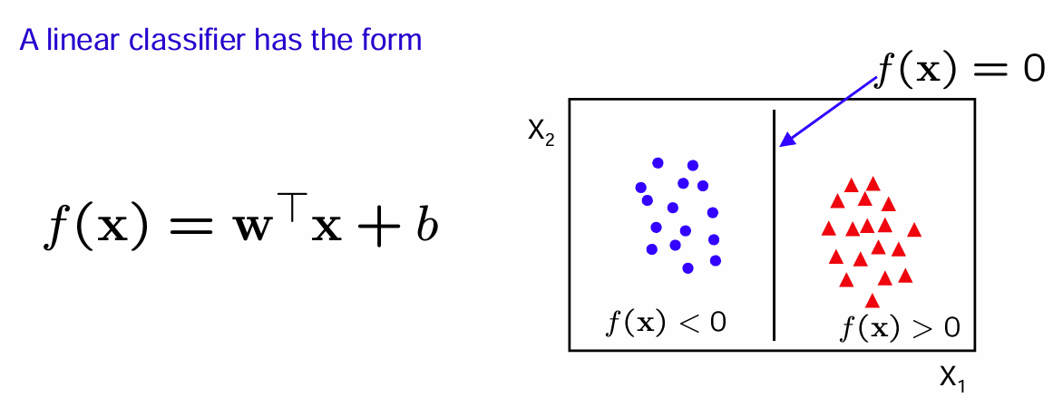

Linear Classifiers
$$f\left(x\right)=w_{1}x_{1}+w_{2}x_{2}+b$$

Slide 21
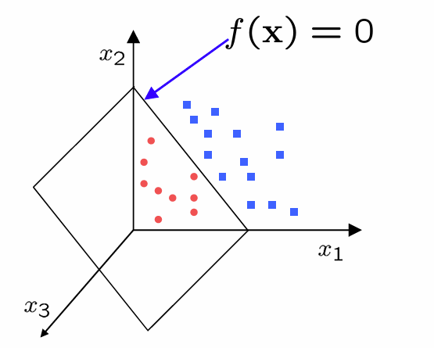
In higher dimensions (3D, …)

Slide 22
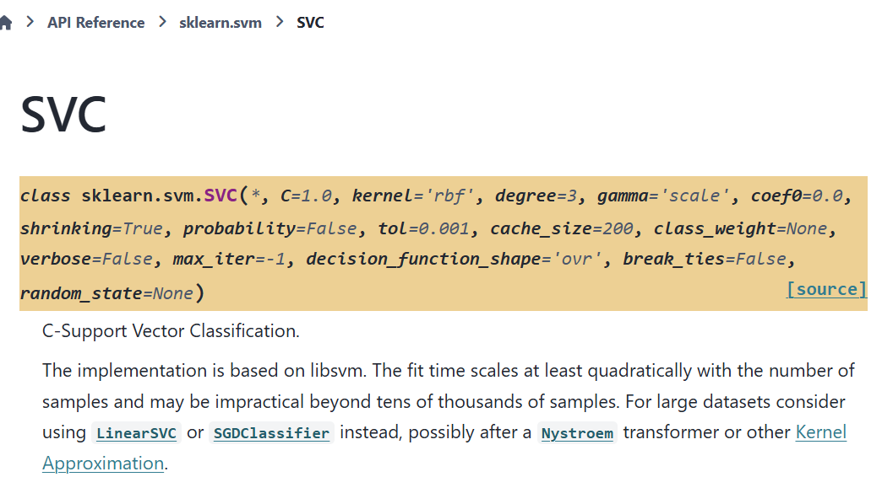
C-Support Vector Classification
SVC — scikit-learn 1.6.1 documentation

Slide 23
C-Support Vector Classification
Controls the kernel (for non-linear decisions boundaries)
SVC — scikit-learn 1.6.1 documentation

Slide 24
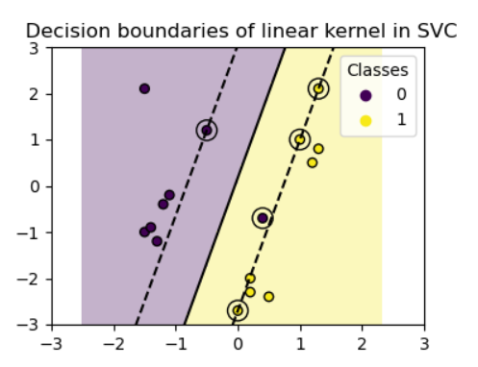
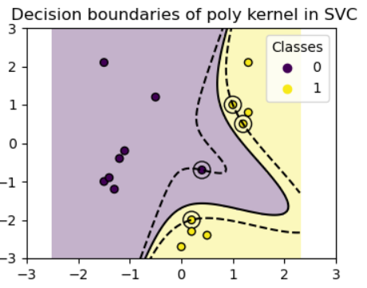
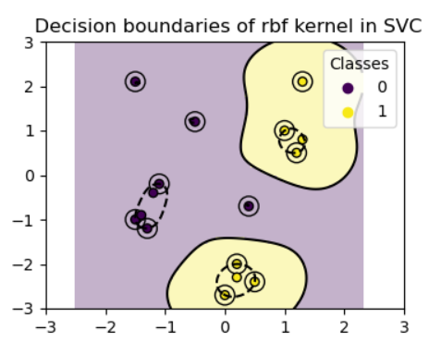
SVM Kernel Impact on Decision Boundary
Run the code in this page and experiment with different kernels. Plot classification boundaries with different SVM Kernels — scikit-learn 1.6.1 documentation
Linear Kernel
Poly Kernel
RBF Kernel

Slide 25
C-Support Vector Classification
C controls overfitting: regularization parameter. The strength of the regularization is inversely proportional to C. Must be strictly positive.
SVC — scikit-learn 1.6.1 documentation

Slide 26
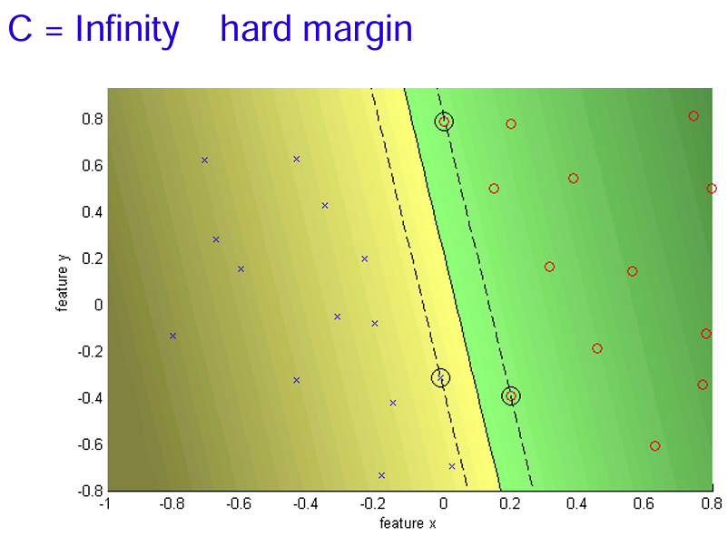
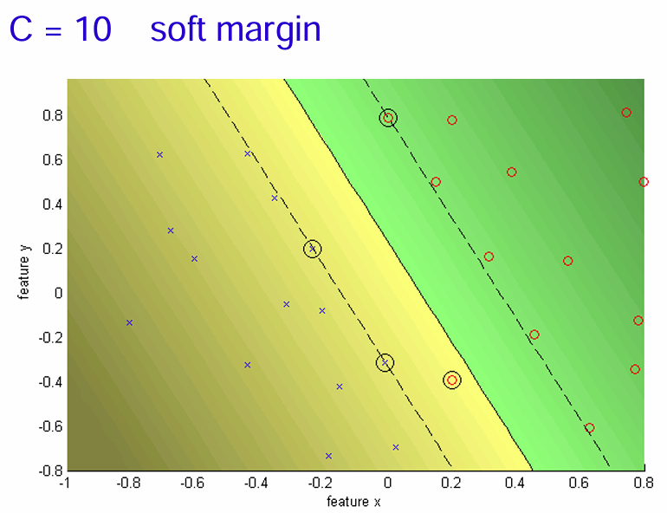
Smaller Margin, but no training errors
Much larger margins, but some training errors

Slide 27
C-Support Vector Classification
SVC — scikit-learn 1.6.1 documentation
The fit time scales at least quadratically with the number of samples and may be impractical beyond tens of thousands of samples.

Slide 28
Support Vector Machine pitfalls
Data needs to be scaled
Use the right kernel for the job:
Linear
Polynomial
Radial Basis Function
Sigmoid
Data needs to be scaled! (do not forget!)

Slide 29
Summary
One strategy to classify is to use linear classifiers, but change the shape of the data such that we get a linear decision boundary
Features are sometimes designed such that we get linearly separable boundaries
Alternatively, you can use kernels, these focus on measuring the similarity of two data points.
For each kernel there is a feature space, sometimes the feature space can be infinite dimensional, as in RBF while the kernel is easy to compute.

Slide 30
Summary: Linear Classifiers
This is what a linear classifier does: it tries to draw a simple, straight boundary between two categories.
But here's the catch: Sometimes, the data isn't shaped in a way that allows us to do this easily.

Slide 31
Summary - Features: Changing the Data Shape
You can reshape or transform your data in a way that makes it easier to separate.
For example, if the data was shaped in a curve or circle, transforming it might make it look like two groups that can be separated by a straight line.
You can also add new features (new columns to your dataframe).

Slide 32
Summary - Kernels
A kernel is a function that helps us measure how "similar" two data points are.
Rather than trying to directly draw a straight line between points, we measure how close they are in some hidden space. ➔ for every two row in your dataframe, it gives a scalar value
We only need to define the similarity of points (inner product of two rows in some feature space) instead of defining how to transform data.

Slide 33
Kernel Trick
While this hidden feature space can be very complex (sometimes even infinite!), we can still compute the similarity in that space using a kernel, without needing to deal with all that complexity directly.
For example RBF kernel corresponds to the inner product of an infinite number of features.

Slide 34
Support Vector Machines
Any questions?

